Slide 1
Forces Sandbox Presentation #4
James Crocker, James Hribal, Alex Athimaritis

Slide 2
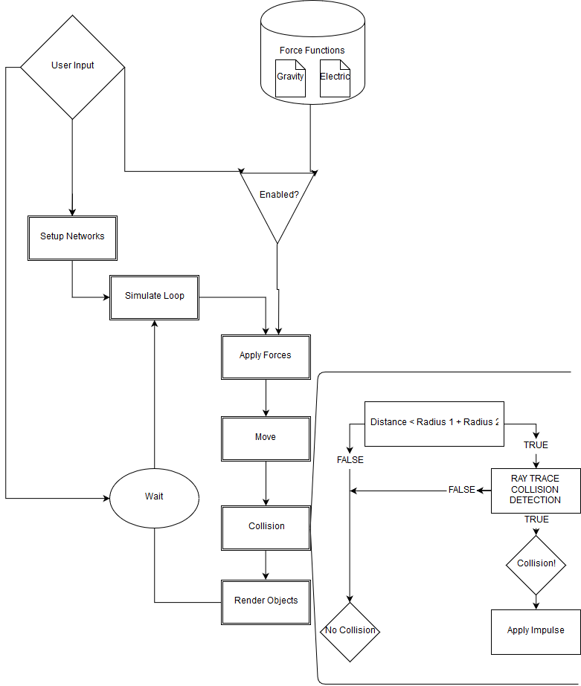
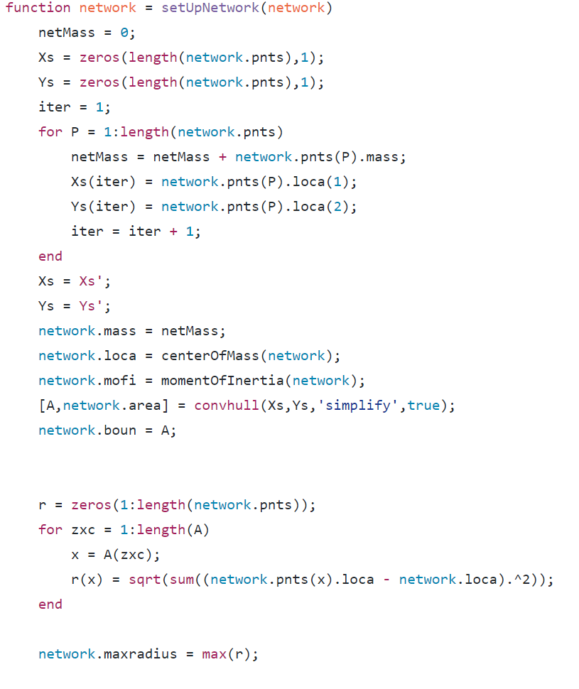

Slide 3
Going Forward
Documentation is being added to make it easier for anyone who wants to add on to this project in future years
Code allows for forces to be applied to each point in the network
Also allows for forces to be applied to the networks as a whole
Implementation of different types of forces
Buoyancy
Torque
Etc.
Customizable shapes of networks
Create objects upon mouse click (code was being started)

Slide 4
Demo

